Slide 1
Introduction
Fullstack developer - JavaScript

Slide 2

@kevinderudder
: Full-Stack developer
: Competence Manager

Slide 3


Slide 4
Who are you
Name
Role
Experience

Slide 5
Course starts at 9:00
Course ends at 16:45 – 17:00
Breaks
Morning break: 15min
Afternoon break: 15min
Lunch: 60min

Slide 6
TypeScript + JS
Arcelor Fullstack developer

Slide 7
In this chapter you will learn the JavaScript and TypeScript needed to create modern Angular applications

Slide 8
Agenda
TypeScript Introduction
Scope
Objects
Functions
OO Programming in JavaScript
RxJS
async/await
Modules
Classes
Code features
...

Slide 9



We assume that you know
But, if something is unclear, do not hesitate to ask!

Slide 10
TypeScript
1
Introduction

Slide 11
Problem with JavaScript
JavaScript is based on a language that wasn’t meant to be used in big data applications
With the arrival of ES5 and ES6, more and more OO features were added to the ECMA standards
But
No type support
Not every feature is supported in all browsers

Slide 12
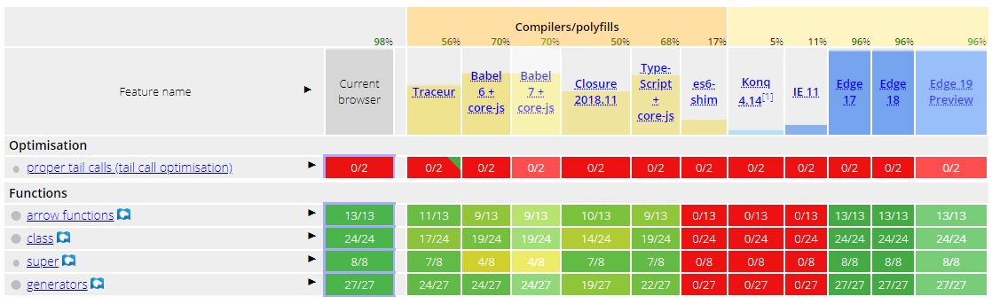
Problem with JavaScript
JavaScript is untyped
Not all new ES features are supported in all browsers
var name = "kevin";
name = 42;
class Course{
}

Slide 13

What is TypeScript
is a strongly typed language that catches many development errors at compile time
Transpiles type-safe code into JavaScript
ES5
Adds more OO features than the current JavaScript standards

Slide 14
!
TypeScript is not a new language
TypeScript is a superset of JavaScript

Slide 15


JavaScript

Slide 16
Before we proceed
We will mix TypeScript and JavaScript!
On the right-upper side of the slide you will see if the feature is a (only) TypeScript feature or a JavaScript feature
If it is a JavaScript feature, it can also be used in TypeScript

Slide 17
TypeScript
2
TSLint

Slide 18
TSLint
TSLint is an extensible static analysis tool that checks TypeScript code for readability, maintainability, and functionality errors. It is widely supported across modern editors & build systems and can be customized with your own lint rules, configurations, and formatters.
https://palantir.github.io/tslint/

Slide 19
Get started - installation
npm install -g typescript tslint

Slide 20


Slide 21
TypeScript
3
Type system

Slide 22
Type System
JavaScript supports datatypes
number, string, boolean, null, undefined, object (array, function)
But is loosely typed
TypeScript supports all the existing JavaScript datatypes
But typed

Slide 23
Type System
JavaScript supports datatypes
number, string, boolean, null, undefined, object (array, function)
But is loosely typed
TypeScript supports all the existing JavaScript datatypes
But typed
That’s why it is called TypeScript

Slide 24
Type System
Untyped
Typed
var untyped = 42;
untyped = "Kevin"
var typed:number = 42;
typed = "Kevin"
ERROR

Slide 25
Type System
// boolean
var isDeleted: boolean = false;
// number
var age: number = 42;
var hex: number = 0xf00d;
var bin: number = 0b1010;
var oct: number = 0o644;
// string
var firstname: string = "Kevin";
var lastname: string = "DeRudder";
var fullname: string = `${ firstname } ${lastname}`

Slide 26
Type System
// Array
var players: string[] = ["Odjidja", "Esiti", "Asare"];
var friends: Array<string> = ["Nathalie Emmanuel"];
// Tuple
var playerandnumber: [number, string] = [1, "Kalinic"];
// Enum
enum Gender { Female = 1, Male };
var g: Gender = Gender.Female;
// Any
var dunno: any = 42;
dunno = "kevin";

Slide 27
Type assertions
var ageInput: any = "42";
var age: number = <number>ageInput;

Slide 28
Scope
4

Slide 29
DEFINITION

Slide 30
DEFINITION
Scope is where the compiler looks for variables and functions when they need to be accessed

Slide 31
DEFINITION
where
Scope is where the compiler looks for variables and functions when they need to be accessed
Global Scope
Local Scope

Slide 32
Global Scope
Defined outside function
var globalScope = "global";
function checkScope() {
var localScope = "local";
}

Slide 33
Local Scope
var globalScope = "global";
function checkScope() {
var localScope = "local";
}
Defined inside function

Slide 34

Don’t forget var
function dontForgetVar(){
localScope = "should only be available in this function";
}
dontForgetVar();
alert(localScope);

Slide 35
Lexical scope
Also known as compile-time scope
type of scope is determined during compilation
During the executing process, the interpreter looks for assignments in the current scope.
If not found, it goes up the tree through the parent scope until the global scope
If the declaration is not found, a Reference error is thrown
ReferenceError

Slide 36
Lexical scope
Function scope
Block scope
vs

Slide 37
Lexical scope
Function scope
Block scope
vs
var
let or const

Slide 38
Function scope
Interpreter declares a variable in its current scope Function scope
The variable can only be used inside the function and its children.
The variable cannot be accessed from outside the function
function functionscope() {
for (var i = 0; i < 10; i++) {
console.info(i);
}
console.info(i);
}
i is accessible outside the for-loop

Slide 39
Block scope
Like the function scope but limited to the block where it has been declared
function functionscope() {
for (let i = 0; i < 10; i++) {
console.info(i);
}
console.info(i);
}
i is NOT accessible outside the for-loop

Slide 40
function var_demo():void {
for (var i = 0; i < 10; i++) {
// do some crazy stuff
}
console.log(i);
}
function var_demo():void {
for (let i = 0; i < 10; i++) {
// do some crazy stuff
}
console.log(i);
}
i is scoped to the function – function scope
i is scoped to the block – block scope
i = 10
ERROR

Slide 41
let and const
Declare block scope variables instead of function scope variables
Principle of least disclosure
variable should only be accessible in the smallest scope possible
Advantages
avoid bad acces to variables
garbage collector can clean unused variables

Slide 42

PROTIP
use let or const

Slide 43
FYI
Article on var vs let vs const
https://medium.com/javascript-scene/javascript-es6-var-let-or-const-ba58b8dcde75

Slide 44
Functions
5
Important in Programming Languages
More important in JavaScript or TypeScript

Slide 45
Functions
Important in Programming Languages
More important in JavaScript or TypeScript
Before ES6, pretty much everything was based on functions
3 types of functions
Named functions
Anonymous functions
Arrow functions

Slide 46
Types of functions
function update(p) { }
Named function
var onUpdated = function (p) { }
Anonymous function
var onUpdated = (p) => {}
Arrow function

Slide 47
what is
this
?

Slide 48
Execution context
Functions have a reference to the execution context
specifies how they are called
IMPORTANT
execution context is about how your function is called during execution of the code
not how it was when the function has been declared
Referencing the execution context via this

Slide 49
Basic function call
We call init from the global scope, so the execution context will point to the global scope
function init() {
q = 12;
}
init();

Slide 50
Basic function call – execution context
function handleClick(){
console.log(this);
}
handleClick();
let txt = document.querySelector("#demoButton");
txt.addEventListener("click", handleClick);
function handleClick(){
console.log(this);
}

Slide 51
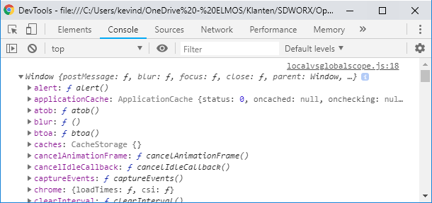
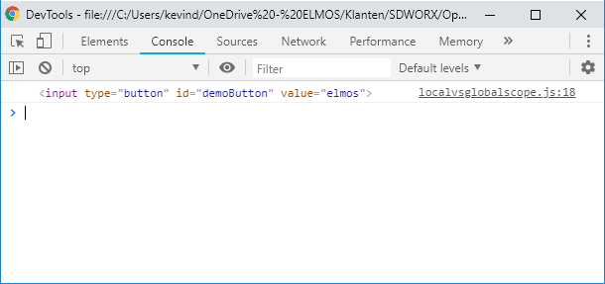
Basic function call – execution context
function handleClick(){
console.log(this);
}
handleClick();
let txt = document.querySelector("#demoButton");
txt.addEventListener("click", handleClick);
function handleClick(){
console.log(this);
}

Slide 52
new()
Might be familiar with the ones you know from OO languages
but is not 100% the same
new()
creates a new object, which inherits from an Object.prototype
the created object gets passed in as the this context
if the constructor does not return its own object, then the new object is returned

Slide 53
new()
function Course(title, teacher) {
this.title = title;
this.teacher = teacher;
}
const c = new Course("JavaScript", "Kevin");

Slide 54
new()
function Course(title, teacher) {
this.title = title;
this.teacher = teacher;
}
const c = new Course("JavaScript", "Kevin");
Created object is passed in as this

Slide 55
new()
function Course(title, teacher) {
this.title = title;
this.teacher = teacher;
}
const c = new Course("JavaScript", "Kevin");
Created object is passed in as this
The created object is returned since the constructor doesn’t return an object

Slide 56

new()
function Course(title, teacher) {
this.title = title;
this.teacher = teacher;
}
const c = new Course("JavaScript", "Kevin");
Created object is passed in as this
The created object is returned since the constructor doesn’t return an object
Really?

Slide 57
classes
class Course{
}

Slide 58
classes
class Course{
constructor(title, teacher){
this.title = title;
this.teacher = teacher;
}
}
let c = new Course("JavaScript", "Kevin");

Slide 59
Arrow functions
Since ES6
Shorter syntax than a function expression and does not bind its own this

Slide 60
Arrow functions
function Course(title, teacher) {
this.title = title;
this.teacher = teacher;
this.busy = 0;
setInterval(function keepGoing() {
this.busy++; // this refers to the global object
}, 1000);
}
ERROR

Slide 61
Arrow functions
FIX
function Course(title, teacher) {
this.title = title;
this.teacher = teacher;
var that = this;
this.busy = 0;
setInterval(function keepGoing() {
that.busy++;
}, 1000);
}}

Slide 62
Arrow functions
Arrow functions do not have a this keyword. The function treats this like any other variable in the lexical scope and looks up this in its parent’s scope
function Course(title, teacher) {
this.title = title;
this.teacher = teacher;
this.busy = 0;
setInterval(() => {
this.busy++;
}, 1000);
}

Slide 63
Functions
6
Typed
Parameters

Slide 64
Exercise
let sum = add(1,6,7); // 14
sum = add(8,9); // 17

Slide 65
Functions and types
function addPerson(firstname:string, lastname:string):Person{
return new Person(firstname, lastname);
}

Slide 66
Functions and types
Typed parameters
Return type
function addPerson(firstname:string, lastname:string):Person{
return new Person(firstname, lastname);
}

Slide 67
Optional parameters
function sendMail(message: string, to: Person, cc?: Person): void {
if (cc) { }
}

Slide 68
Default parameters
function addToBasket(productId: number, quantity: Number = 1){
}
Default parameters at the end of the parameterlist

Slide 69
Rest parameters
Default and optional parameters point to 1 parameter
Rest parameters allow you to send an array of items
Use ... in front of the parameter
...
function sendMail(message: string, to:Person, ...cc:Person[]) {
}

Slide 70
Classes
7

Slide 71
<= ES5: Classes
Creating objects has been possible since ES3
Faked with functions
function Person(firstname, name) { }
var kevin = new Person("Kevin", "DeRudder");
// OR
Object.create(Person, {});

Slide 72
ES6: Classes
class Person {
constructor(firstname, name) {
this.firstname = firstname;
this.name = name;
}
toString() {
return `${this.firstname} ${this.name}`;
}
}

Slide 73
TypeScript Classes
class Person {
constructor(firstname: string, name: string) {
this.firstname = firstname;
this.name = name;
}
toString() {
return `${this.firstname} ${this.name}`;
}
}

Slide 74
Inheritance
class Person {
firstname: string; name: string;
constructor(firstname: string, name: string) {
this.firstname = firstname;
this.name = name;
}
toString() {
return `${this.firstname} ${this.name}`;
}
}
class Actor extends Person {
movies: string[];
toString() {return `${super.toString()}
plays in ${this.movies.length} movies`;}
}

Slide 75
Modifiers
Like in other OO languages, modifiers determine how objects can be accessed
public
Default (because it is JavaScript)
Available in- and outside your project
private
Cannot be accessed outsite its containing class
protected
Like private but available in derived classes

Slide 76
Modifiers
class Person{
public firstname;
public lastname;
constructor(firstname:string,lastname:string){
this.firstname = firstname;
this.lastname = lastname;
}
}

Slide 77
Modifiers – shorthand syntax
class Person{
constructor(public firstname:string, public lastname:string){
}
}

Slide 78
Parameters
Create and initialize a member in one place
Readonly
constructor(firstname: string, name: string) {
this.firstname = firstname;
this.name = name;
}
constructor(readonly firstname: string, readonly name: string) {
this.firstname = firstname;
this.name = name;
}

Slide 79
Properties
Accessors or getters and setters
Syntax similar to ES5
get FirstName(): string {
return this.firstname;
}
set FirstName(v: string) {
this.firstname = v;
}

Slide 80
Static Properties and Methods
Or non-instance members
class Money {
static DollarCurrency: number;
static ConvertToDollar(amountInEuro: number): number {
return amountInEuro * Money.DollarCurrency;
}
}
var result = Money.ConvertToDollar(100);

Slide 81
Abstract Classes
Base classes which are used to be derived from
Not possible to instantiate directly
abstract class Person {
constructor(public firstname: string, public name: string) { }
}
class Teacher extends Person {
constructor(public firstname: string, public name: string) {
super(firstname, name);
}
}
var p = new Person("Kevin", "DeRudder");
var t = new Teacher("Kevin", "DeRudder");
COMPILER ERROR
OK

Slide 82
Abstract classes and methods
Abstract Methods in an abstract class must be implemented in derived classes
Have no implementation
abstract class Person {
constructor(public firstname: string, public name: string) { }
abstract sendMail(): void;
}
class Teacher extends Person {
constructor(public firstname: string, public name: string) {
super(firstname, name);
}
sendMail(): void { }
}

Slide 83
Interfaces
8

Slide 84
DEFINITION

Slide 85
Interfaces
What’s the shape of a value?
This is where interfaces come into play
Define contract(s) within your code
And outside your project
interface ILicenseToKill {
kill():void;
}
class SecretAgent implements ILicenseToKill{
kill(): void {}
}

Slide 86
Interfaces
What’s the shape of a value?
This is where interfaces come into play
Define contract(s) within your code
And outside your project
interface ILicenseToKill {
kill():void;
}
class SecretAgent implements ILicenseToKill{
kill(): void {}
}

Slide 87
Modules
9

Slide 88
Modular programming
No matter which library / framework you choose
Module programming is not something typical to TypeScript or JavaScript
ECMA Standard
Modular programming is KEY

Slide 89

Modular programming
Modular programming is like playing with lego
combine building blocks

Slide 90

Modular programming
Sort
module
Crunch-module
Data-module

Slide 91


Modular programming
Sort
module
Crunch-module
Data-module

Slide 92
Modular programming
Sort
module
Crunch-module
Data-module

Slide 93
Small unit of independent, reusable code

Slide 94
YOUR APPLICATION
Small unit of independent, reusable code

Slide 95
YOUR APPLICATION
Small unit of independent, reusable code
Small unit of independent, reusable code
Small unit of independent, reusable code
Small unit of independent, reusable code
Small unit of independent, reusable code
Small unit of independent, reusable code
Small unit of independent, reusable code
Small unit of independent, reusable code
Small unit of independent, reusable code
Small unit of independent, reusable code
Small unit of independent, reusable code
Small unit of independent, reusable code

Slide 96
YOUR APPLICATION
Small unit of independent, reusable code
Small unit of independent, reusable code
Small unit of independent, reusable code
Small unit of independent, reusable code
Small unit of independent, reusable code
Small unit of independent, reusable code
Small unit of independent, reusable code
Small unit of independent, reusable code
Small unit of independent, reusable code
Small unit of independent, reusable code
Small unit of independent, reusable code
Small unit of independent, reusable code

Slide 97
Why Modules
Maintainability
Modules are self-contained
Grow and improve independently
Namespacing
Scoping of variables
Reusability
Testability

Slide 98
Modules and Scope
Modules are executed in their own scope, NOT IN THE GLOBAL SCOPE
Everything created in the module only exists in the module
Unless you export it...
export class Math {
static Sqrt(v: number): number { return 0; }
}
import { Math } from "./Math"
Math.Sqrt(6);

Slide 99
Import everything
import { * as m } from "./Math"
Math.Sqrt(6);

Slide 100
Default export
person.ts
export default class Person{
constructor(public firstname:string, public lastname:string){}
}
app.ts
import Person from './person';

Slide 101
Language
11
Callbacks, promisses and async

Slide 102
Take a look at following code
let xmlHttp = new XMLHttpRequest();
xmlHttp.onload = () => {
if(xmlHttp.readyState === 4 && xmlHttp.status === 200){
// do some HTML Stuff!!!
}
};
xmlHttp.send('GET', url, true);
It is not very logic that we write html code in the onload function?

Slide 103
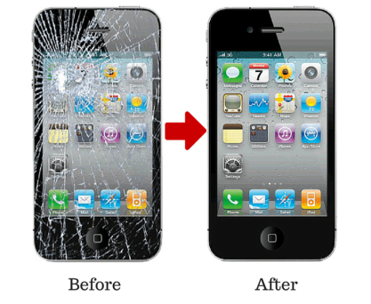

Slide 104
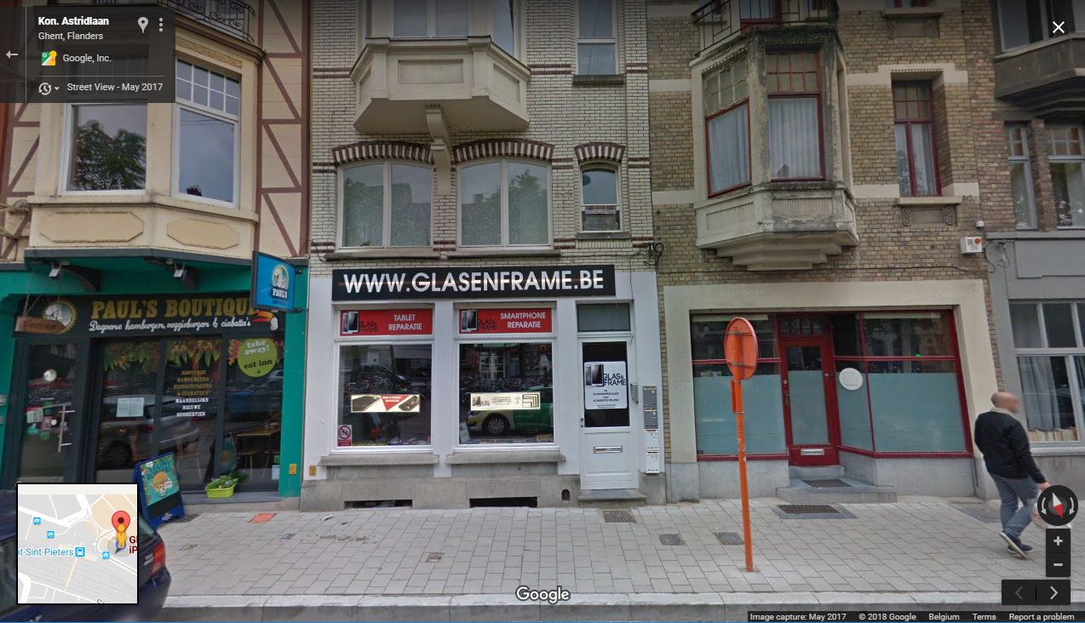

Slide 106
In our code
You start to use your phone in the shop, and only in the shop
let xmlHttp = new XMLHttpRequest();
xmlHttp.onload = () => {
if(xmlHttp.readyState === 4 && xmlHttp.status === 200){
// do some HTML Stuff!!!
}
};
xmlHttp.send('GET', url, true);

Slide 107

How do we even know,
when our phone is fixed?

Slide 108

Is my phone ready?

Slide 109
Is my phone ready?
Is it fixed yet?

Slide 110
Is my phone ready?
Is it fixed yet?
And now?

Slide 111

Is my phone ready?
Is it fixed yet?
And now?

Slide 112

Callback
Your phone is ready?

Slide 113
let fix_telephone = function(url, callThisNumber){
let xmlHttp = new XMLHttpRequest();
xmlHttp.onload = () => {
if(xmlHttp.readyState === 4 && xmlHttp.status === 200){
callThisNumber("Your phone is ready!");
}
};
xmlHttp.send('GET', url, true);
};

Slide 114
let fix_telephone = function(url, callToThisNumber){
let xmlHttp = new XMLHttpRequest();
xmlHttp.onload = () => {
if(xmlHttp.readyState === 4 && xmlHttp.status === 200){
callToThisNumber("Telefoon is klaar!");
}
};
xmlHttp.send('GET', url, true);
};
function make_phonecalls(){
console.log("making a phone call");
}
function call_me_on_this_number_when_fixed(){
make_phonecalls();
}
fix_telephone("glas en frame", call_me_on_this_number_when_fixed);

Slide 115
Callback disadvantages
Callback is a function
Functions are not designed to be used like this
Not very readable
Functions cannot be chained
If this is done, do this, etc.

Slide 116
Promises
Promise === object
Represents the eventual completion of an asynchronous operation, and its resulting value
https://developer.mozilla.org/en-US/docs/Web/JavaScript/Reference/Global_Objects/Promise
Can only be executed once
Or it succeeds
Or it fails

Slide 117
let fix_telephone = function(url){
let promise = new Promise(function(success, failure){
let xmlHttp = new XMLHttpRequest();
xmlHttp.onload = () => {
if(xmlHttp.readyState === 4 && xmlHttp.status === 200){
success("your phone is ready!");
}
};
xmlHttp.onerror = () => {
failure("oops");
};
xmlHttp.send('GET', url, true);
});
return promise;
};

Slide 118
let fix_telephone = function(url){
let promise = new Promise(function(success, failure){
let xmlHttp = new XMLHttpRequest();
xmlHttp.onload = () => {
if(xmlHttp.readyState === 4 && xmlHttp.status === 200){
success("your phone is ready!");
}
};
xmlHttp.onerror = () => {
failure("oops");
};
xmlHttp.send('GET', url, true);
});
return promise;
};
creation of an object

Slide 119
function make_phonecalls(){
console.log("making a phone call");
}
function buy_new_phone(){
}
fix_telephone("glas en frame").then(make_phonecalls, buy_new_phone);
success
failure

Slide 120
async
Built on top of promises
New way of working with asynchronous operations

Slide 121
Performance Guidelines + Tools
12

Slide 122

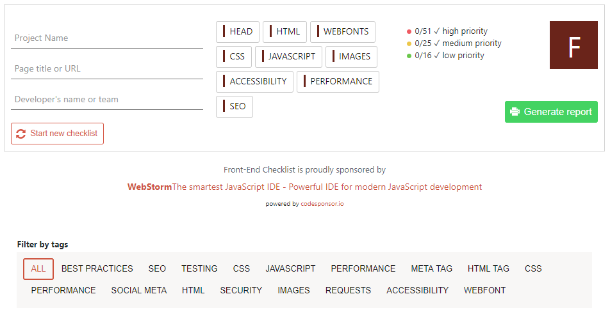
https://frontendchecklist.io/

Slide 123
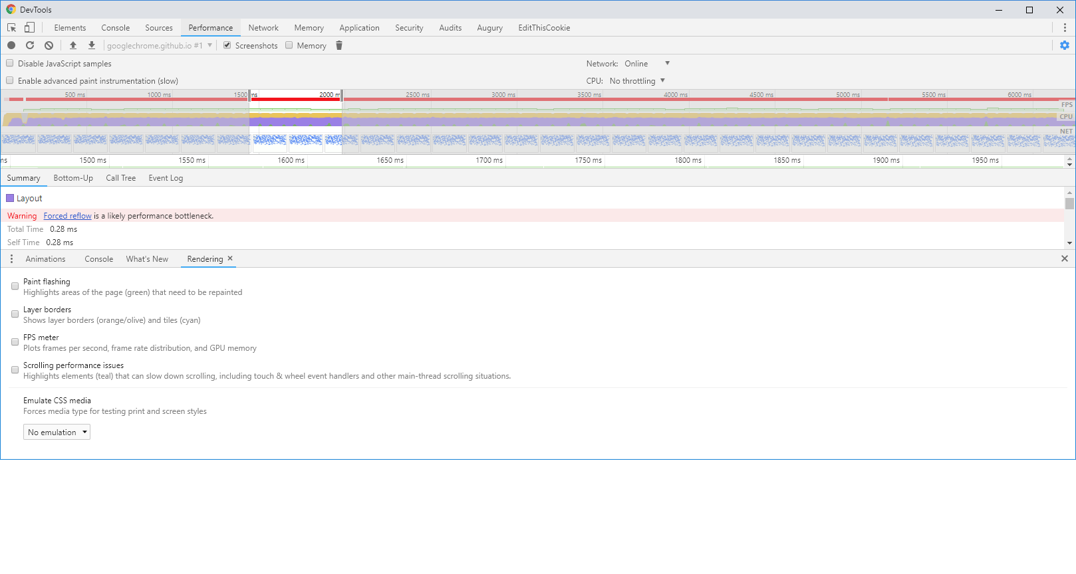

Slide 124


Slide 125
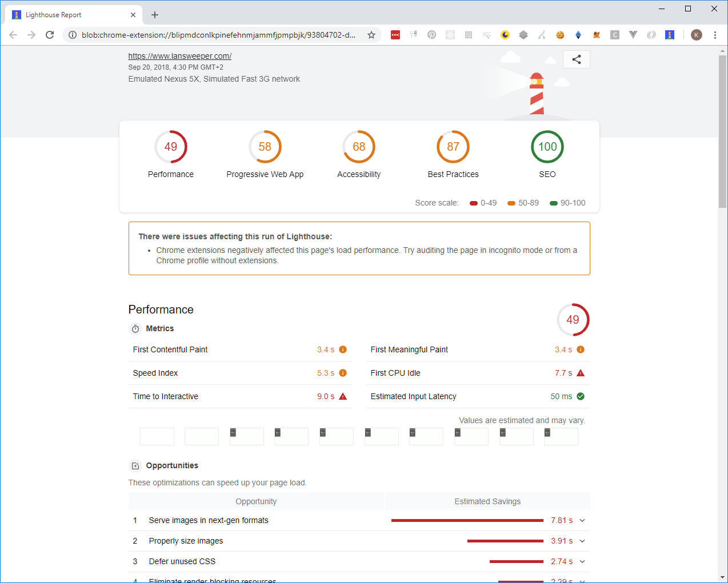

Slide 126


Slide 127
Performance Quickwins
12

Slide 128
Quickwins
“use strict”;
START WITH

Slide 129

Quickwins
USE LATEST
standards

Slide 130
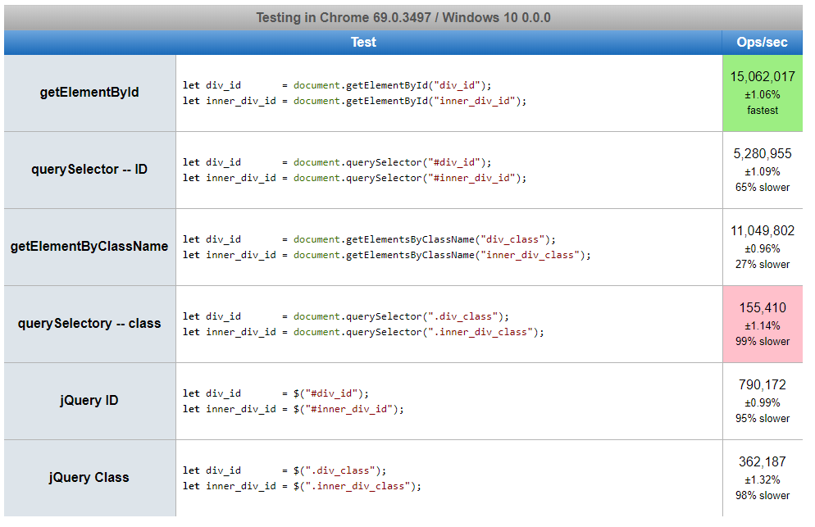
getElementById querySelector
vs
TEST 1

Slide 131
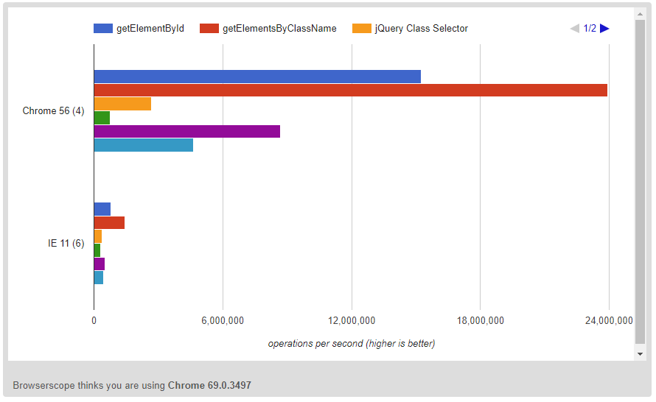
getElementById querySelector
vs
TEST 1

Slide 132
Performance Loops
12

Slide 133
Normal for loop
for(let i = 0 ; i < arr.length ; i++){
console.log(arr[i]);
}

Slide 134
Normal for loop
Length is checked every iteration
for(let i = 0 ; i < arr.length ; i++){
console.log(arr[i]);
}

Slide 135
Normal for loop
Cache the length
for(let i = 0, l = arr.length ; i < l ; i++){
console.log(arr[i]);
}

Slide 136
Normal for loop
Loop backwards
for(let i = arr.length ; i >= 0 ; i--){
console.log(arr[i]);
}

Slide 137
Performance Document Object Model
12

Slide 138

THIS ISN’T A QUICKWIN BUT A BIGWIN

Slide 139

DOM
!==

Slide 140
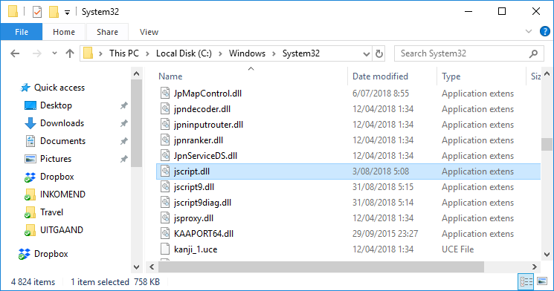
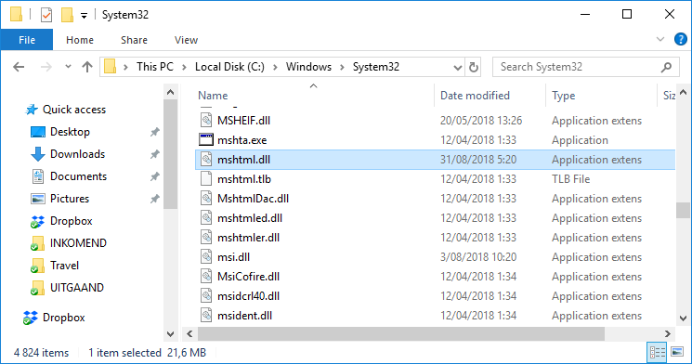
!==

Slide 141

function OHMY(){
for(let i = 0 ; i < 1000 ; i++){
document.getElementById("an_element");
}
}

Slide 142
Critical Rendering Path
DOM
CSSOM
RENDER TREE
LAYOUT
PAINT
Notes:
First of all, it would be useful to understand the steps the browser is actually going through. It starts with plain HTML, CSS, and JavaScript files goes through rendering and painting a page, and arrives in the end to become what the user sees.
These steps from your different HTML, CSS, and JS files to a painted page are commonly referred to as the Critical Rendering Path (or CRP for short).
The Critical Rendering Path consists of five different steps, which are best explained in a graphic.
In the image above, we can see the root element that encompasses all its children which in turn are parents that contain children as well. Put that upside down and it will look almost like a tree!
The DOM thus represents our complete HTML markup. As you saw, it is built up incrementally by processing the tokens and converting them into nodes. In fact, we can use that to our advantage by returning partial HTML and giving our user the indication that something is happening and rendering on the page.
After constructing the DOM, your browser will process the CSS and build the CSS Object Model (CSSOM). This process is very similar to building the DOM. But in this process, as opposed to before, the child nodes inherit their parent nodes’ styling rules — hence the name Cascading Style Sheets (CSS).
Unfortunately, we can’t incrementally process partial CSS like we could with the DOM, as it could easily lead to applying the wrong styles if an overriding style comes later in the process. This is the reason why CSS is render blocking, as the browser needs to stop rendering until it receives and processes all the CSS.
Our DOM tree and CSSOM tree will contain all the nodes and dependencies that we have in our page.
First of all, it would be useful to understand the steps the browser is actually going through. It starts with plain HTML, CSS, and JavaScript files goes through rendering and painting a page, and arrives in the end to become what the user sees.
These steps from your different HTML, CSS, and JS files to a painted page are commonly referred to as the Critical Rendering Path (or CRP for short).
The Critical Rendering Path consists of five different steps, which are best explained in a graphic.
In the image above, we can see the root element that encompasses all its children which in turn are parents that contain children as well. Put that upside down and it will look almost like a tree!
The DOM thus represents our complete HTML markup. As you saw, it is built up incrementally by processing the tokens and converting them into nodes. In fact, we can use that to our advantage by returning partial HTML and giving our user the indication that something is happening and rendering on the page.
After constructing the DOM, your browser will process the CSS and build the CSS Object Model (CSSOM). This process is very similar to building the DOM. But in this process, as opposed to before, the child nodes inherit their parent nodes’ styling rules — hence the name Cascading Style Sheets (CSS).
Unfortunately, we can’t incrementally process partial CSS like we could with the DOM, as it could easily lead to applying the wrong styles if an overriding style comes later in the process. This is the reason why CSS is render blocking, as the browser needs to stop rendering until it receives and processes all the CSS.
Our DOM tree and CSSOM tree will contain all the nodes and dependencies that we have in our page.
First of all, it would be useful to understand the steps the browser is actually going through. It starts with plain HTML, CSS, and JavaScript files goes through rendering and painting a page, and arrives in the end to become what the user sees.
These steps from your different HTML, CSS, and JS files to a painted page are commonly referred to as the Critical Rendering Path (or CRP for short).
The Critical Rendering Path consists of five different steps, which are best explained in a graphic.
In the image above, we can see the root element that encompasses all its children which in turn are parents that contain children as well. Put that upside down and it will look almost like a tree!
The DOM thus represents our complete HTML markup. As you saw, it is built up incrementally by processing the tokens and converting them into nodes. In fact, we can use that to our advantage by returning partial HTML and giving our user the indication that something is happening and rendering on the page.
After constructing the DOM, your browser will process the CSS and build the CSS Object Model (CSSOM). This process is very similar to building the DOM. But in this process, as opposed to before, the child nodes inherit their parent nodes’ styling rules — hence the name Cascading Style Sheets (CSS).
Unfortunately, we can’t incrementally process partial CSS like we could with the DOM, as it could easily lead to applying the wrong styles if an overriding style comes later in the process. This is the reason why CSS is render blocking, as the browser needs to stop rendering until it receives and processes all the CSS.
Our DOM tree and CSSOM tree will contain all the nodes and dependencies that we have in our page.
First of all, it would be useful to understand the steps the browser is actually going through. It starts with plain HTML, CSS, and JavaScript files goes through rendering and painting a page, and arrives in the end to become what the user sees.
These steps from your different HTML, CSS, and JS files to a painted page are commonly referred to as the Critical Rendering Path (or CRP for short).
The Critical Rendering Path consists of five different steps, which are best explained in a graphic.
In the image above, we can see the root element that encompasses all its children which in turn are parents that contain children as well. Put that upside down and it will look almost like a tree!
The DOM thus represents our complete HTML markup. As you saw, it is built up incrementally by processing the tokens and converting them into nodes. In fact, we can use that to our advantage by returning partial HTML and giving our user the indication that something is happening and rendering on the page.
After constructing the DOM, your browser will process the CSS and build the CSS Object Model (CSSOM). This process is very similar to building the DOM. But in this process, as opposed to before, the child nodes inherit their parent nodes’ styling rules — hence the name Cascading Style Sheets (CSS).
Unfortunately, we can’t incrementally process partial CSS like we could with the DOM, as it could easily lead to applying the wrong styles if an overriding style comes later in the process. This is the reason why CSS is render blocking, as the browser needs to stop rendering until it receives and processes all the CSS.
Our DOM tree and CSSOM tree will contain all the nodes and dependencies that we have in our page.
First of all, it would be useful to understand the steps the browser is actually going through. It starts with plain HTML, CSS, and JavaScript files goes through rendering and painting a page, and arrives in the end to become what the user sees.
These steps from your different HTML, CSS, and JS files to a painted page are commonly referred to as the Critical Rendering Path (or CRP for short).
The Critical Rendering Path consists of five different steps, which are best explained in a graphic.
In the image above, we can see the root element that encompasses all its children which in turn are parents that contain children as well. Put that upside down and it will look almost like a tree!
The DOM thus represents our complete HTML markup. As you saw, it is built up incrementally by processing the tokens and converting them into nodes. In fact, we can use that to our advantage by returning partial HTML and giving our user the indication that something is happening and rendering on the page.
After constructing the DOM, your browser will process the CSS and build the CSS Object Model (CSSOM). This process is very similar to building the DOM. But in this process, as opposed to before, the child nodes inherit their parent nodes’ styling rules — hence the name Cascading Style Sheets (CSS).
Unfortunately, we can’t incrementally process partial CSS like we could with the DOM, as it could easily lead to applying the wrong styles if an overriding style comes later in the process. This is the reason why CSS is render blocking, as the browser needs to stop rendering until it receives and processes all the CSS.
Our DOM tree and CSSOM tree will contain all the nodes and dependencies that we have in our page.
First of all, it would be useful to understand the steps the browser is actually going through. It starts with plain HTML, CSS, and JavaScript files goes through rendering and painting a page, and arrives in the end to become what the user sees.
These steps from your different HTML, CSS, and JS files to a painted page are commonly referred to as the Critical Rendering Path (or CRP for short).
The Critical Rendering Path consists of five different steps, which are best explained in a graphic.
In the image above, we can see the root element that encompasses all its children which in turn are parents that contain children as well. Put that upside down and it will look almost like a tree!
The DOM thus represents our complete HTML markup. As you saw, it is built up incrementally by processing the tokens and converting them into nodes. In fact, we can use that to our advantage by returning partial HTML and giving our user the indication that something is happening and rendering on the page.
After constructing the DOM, your browser will process the CSS and build the CSS Object Model (CSSOM). This process is very similar to building the DOM. But in this process, as opposed to before, the child nodes inherit their parent nodes’ styling rules — hence the name Cascading Style Sheets (CSS).
Unfortunately, we can’t incrementally process partial CSS like we could with the DOM, as it could easily lead to applying the wrong styles if an overriding style comes later in the process. This is the reason why CSS is render blocking, as the browser needs to stop rendering until it receives and processes all the CSS.
Our DOM tree and CSSOM tree will contain all the nodes and dependencies that we have in our page.

Slide 143
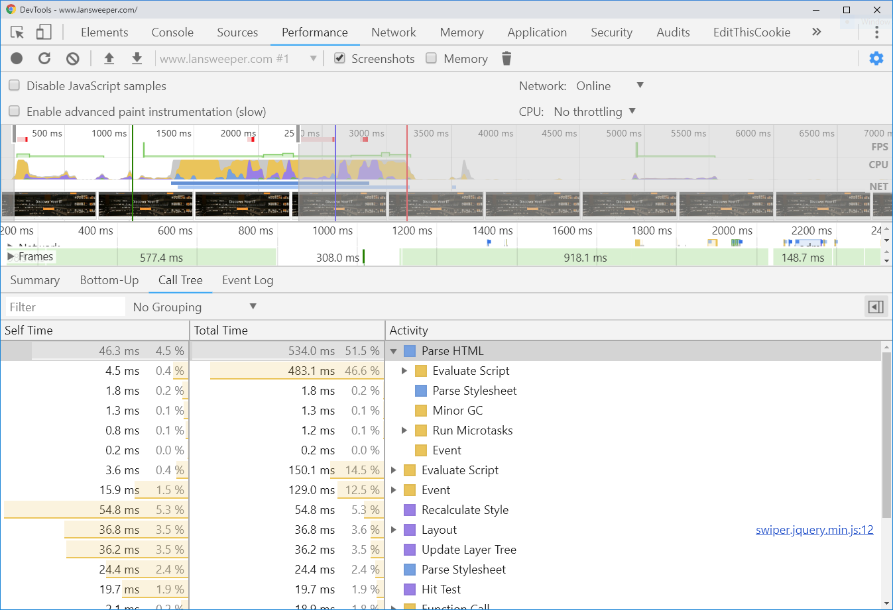

Slide 144
Critical Rendering Path – Visible content
Which nodes are visible?
Render tree is a tree of visible nodes
display: none

Slide 145
Repaints and Reflows
From the moment the browser has downloaded all components, it parses through files and creates 2 structures
DOM tree
representation of the page structure
Render tree
representation of how the DOM nodes are displayed
nodes are called boxes (CSS model: padding, margin, border and position)
Once the trees are constructed, the browser can “paint” the elments

Slide 146
Repaints and Reflows
Reflow
When a DOM action changes the geometry of an element (width, height, thickness of the border, ...), a recalculation needs to happen
Repaint
Once the reflow is complete, the browser repaints the affected parts of the screen
http://www.youtube.com/watch?v=nJtBUHyNBxs
http://www.youtube.com/watch?v=ZTnIxIA5KGw
http://www.youtube.com/watch?v=dndeRnzkJDU

